Slide 1
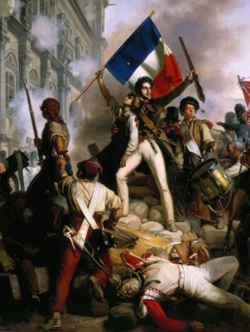
THE FRENCH REVOLUTION

Slide 2
What is a Revolution?
A revolution is basically an action taken by a large group of people to try to change the government, or form of government, of a country; especially by a violent action.

Slide 3
Events of 14th July,1789
On 14th July1789, the city of Paris was in a state of turmoil. The king had commanded the troops to move into the city.
Some 7000 men and women gathered in front of the town hall and decided to form a people’s militia .
They broke into a number of government buildings in search of arms.
A group of several hundred people marched towards the eastern part of the city and stormed the fortress-prison, the Bastille, where they hoped to find weapons.
The commander of the Bastille was killed and the prisoners were released.

Slide 4
Political Causes of French Revolution
In 1774, Louis XVI of the Bourbon family ascended the throne. But he found an empty treasury, as long years of war had drained the financial resources of France.
The cost of maintaining an extravagant court at the Palace of Versailles was also huge.
Under Louis XVI, France had also helped the 13 American colonies gain their independence from the common enemy, Britain.

Slide 5
The war added more debt to the already huge debt, and the lenders who had given the state credit now started charging 10% interest on loans.
To meet its regular expenses, such as the cost of maintaining an army, the court, running government offices and buildings and universities, the state was forced to increase taxes.

Slide 6
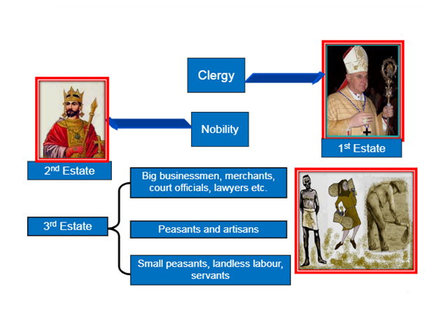
Social Causes of French Revolution

Slide 7
French society in the early 18th century was divided into three estates: The clergy, the nobility and the third estate. Only members of the third estate paid taxes.
Peasants made up about 90% of the population of France. However, only a small number of them owned the land they cultivated.
60% of the land was owned by the nobles, the Church and other richer members of the third estate.
The members of the Clergy and the Nobility enjoyed certain privileges by birth.

Slide 8
The nobles further enjoyed feudal privileges; this included feudal dues which they extracted from the peasants.
Peasants were obliged to render services to the lord-to work in his house and fields- to participate in building roads or to serve in the army.

Slide 9
Types of Taxes
Tithe- It was a tax levied by the Church comprising of one-tenth of the agricultural produce.
Taille- It was a direct tax that all members of the third estate had to pay to the state.
A number of indirect taxes were levied on items of everyday consumption like salt and tobacco.

Slide 11
Economic Causes of French Revolution
The population of France rose from about 23 million in 1715 to 28 million in 1789. This led to a rapid increase in demand for food grains.
The production of grains could not keep pace with demand. So, the price of bread, the staple diet of the majority rose rapidly.
Most workers were employed as laborers in workshops whose owners fixed their wages. But the wages didn’t keep pace with the rise in prices.
So the gap between the poor and the rich widened. Things became worse whenever a drought or hail occurred which reduced the harvest.
This led to subsistence crisis.

Slide 12
Role of the Middle Class
The 18th century witnessed the emergence of social groups termed as the middle class, who earned their wealth through an expanding overseas trade and from the manufacture of goods.
The third estate also included professions such as lawyers and administrative officials.
They were educated and believed that no group in society should be privileged by birth. Rather, a person’s social position must depend on his merit.

Slide 13
Role of Philosophers
John Locke: In his Two Treatises of the Government, Locke sought to refute the doctrine of the divine and the absolute right of the monarch.
Jean Jacques Rousseau: In The Social Contract, Rousseau proposed a form of government based on a social contract between the people and their representatives. He also put forward the principle of one person one vote.

Slide 14
Montesquieu: In The Spirit of the Laws, Montesquieu proposed a division power within the government between the executive, the legislature and the judiciary. This model of government was put into force in the USA, after the thirteen American colonies declared their independence from Britain.
Their ideas were discussed in salons and coffee-houses and spread among people through books and newspapers. They were often read aloud in groups for the benefit of the illiterate.

Slide 15
Estates General
In France of the Old Regime, the monarch did not have the power to impose taxes according to his will alone.
Rather he had to call a meeting of the Estates General, which would then pass his proposals for new taxes.
The Estates General was a political body to which the three estates sent their representatives. However, the monarch alone could decide when to call a meeting of this body.

Slide 16
Assembly of Estates General, 1789
On 5th May 1789, Louis XVI called together an assembly of the Estates General to pass proposals for new taxes.
The Clergy and Nobility sent 300 representatives each , who were seated in rows facing each other.
The 600 representatives of the Third estates had to stand at the back. It was represented by its more prosperous and educated members. Peasants, artisans and women were denied entry.

Slide 17
Voting in the Estates General in the past had been conducted according to the principle that each estate had one vote.
This time as well, Louis XVI was determined to continue with the same practice.

Slide 18
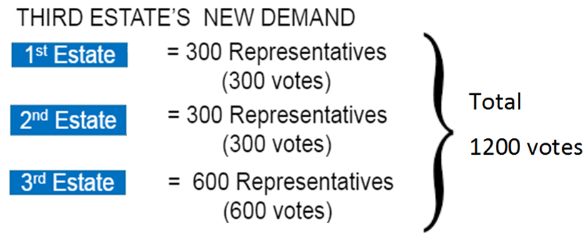
But the members of the Third Estate demanded that voting now be conducted by the assembly as a whole, where each member had one vote.
This idea was put forward by Rousseau in his The Social Contract.

Slide 19
National Assembly
The representatives of the third estate viewed themselves as spokesmen for the entire French nation.
On 20th June 1789, they assembled in the hall of an indoor tennis court in the grounds of Versailles.
They declared themselves as the National Assembly and swore not to disperse until they drafted a constitution for France that limited the powers of the monarch.

Slide 20
The National Assembly was lead by Mirabeau and Abbé Sieyes.
Mirabeau was born in a noble family but was convinced with the need to do away with a society of feudal privilege. He brought put a journal and delivered powerful speeches to the crowd assembled at Versailles.
Abbé Sieyes was originally a priest. He wrote an influential pamphlet called ‘What is the Third Estate’?

Slide 21
The Fall of the Bastille
During this political turmoil, France experienced a severe winter leading to a bad harvest.
This increased the price of bread.
Angry women stormed into shops after waiting for long hours in queues.
At the same time, the King ordered the troops to move into the city.
On 14th July 1789, the crowd stormed and destroyed the Bastille.

Slide 22
Revolt by the peasants
In the countryside, rumors spread from village to village that their ripe crops would be destroyed by bands of brigands, who had been hired by the lords of the manor.
Peasants in several districts seized hoes and attacked the residences of their manors.
They looted hoarded grain and burnt down documents containing records of manorial dues.

Slide 23
Constitutional Monarchy of 1791
The National Assembly completed the draft of the constitution in 1791.
Its main objective was to limit the powers of the monarch.
These powers instead of being concentrated in the hands of one person, were now separated and assigned to the different institutions- the executive, the legislature and the judiciary.

Slide 24
The Constitution of 1791 vested the power to make laws in the National Assembly.
The Constitution began with a Declaration of Rights of Man and Citizen. Rights such as the right to life, freedom of speech, freedom of opinion, equality before law, were established as ‘natural and inalienable rights’, i.e., they belonged to each human being by birth and could not be taken away. It was the duty of the state to protect each citizen’s natural rights.

Slide 25
Voting Rights
Not everyone had the right to vote.
Only men above 25 years of age who paid taxes equal to at least three days of a laborer's wage were given the status of active citizens, i.e., they were entitled to vote.
The remaining men and all women were classed as passive citizens.
To qualify as an elector and then as a member of the Assembly, a man had to belong to the highest bracket of taxpayers.

Slide 26
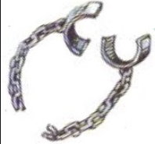
Political Symbols
Broken Chain: Chains were used to fetter slaves. A broken chain stands for the act of becoming free.
Bundle of rods or fasces: One rod can be easily broken. Strength lie in unity.

Slide 27
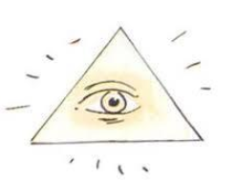
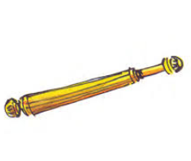
Political Symbols
The eye within a triangle radiating light: The all-seeing eye stands for knowledge. The rays of the sun will drive away the clouds of ignorance.
Sceptre: Symbol of royal power.

Slide 28
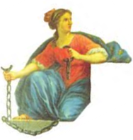
Political Symbols
Snake biting its tail to form a ring: Symbol of Eternity. A ring has neither beginning nor end.
Red Phrygian cap: Cap worn by a slave on becoming free.
Blue-white-red: The national colors of France.

Slide 29
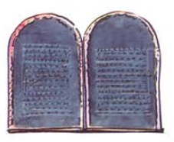
Political Symbols
The winged woman: Personification of the law.
The Law Tablet: The law is same for all and all are equal before it.

Slide 30
Marseillaise
In April 1792, the National Assembly voted to declare war against Prussia and Austria.
Thousands of volunteers thronged from the provinces to join the army.
They saw this as a war of the people against kings and aristocracies all over Europe.
Among the patriotic songs they sang was the ‘Marseillaise’, composed by the poet Roget de L’Isle.
It was sung for the first time by volunteers from Marseilles as they marched into Paris and so it got its name.
The Marseillaise is now the national anthem of France.

Slide 31
Formation of Jacobins Club
Political clubs became an important rallying point for people who wished to discuss government policies and plan their own forms of action.
The most successful of these clubs was that of the Jacobins, which got its name from the former convent of St. Jacob in Paris.

Slide 32
Members of Jacobins Club
The members of the Jacobin club belonged mainly to the less prosperous sections of the society.
They included small shopkeepers, artisans such as shoemakers, pastry cooks, watch-makers, printers, as well as servants and daily-wage workers.
Their leader was Maximilian Robespierre.

Slide 33
Achievements of Jacobin Club
In the summer of 1792 the Jacobins planned an insurrection of a large number of Parisians who were angered by the short supplies and high prices of food.
On the morning of 10th August, they stormed the Palace of the Tuileries, massacred the king’s guards and held the king himself as hostage for several hours.
Later the Assembly voted to imprison the royal family.

Slide 34
Elections were held. From now on all men of 21 years and above, regardless of wealth, got the right to vote.
The newly elected assembly was called the Convention. On 21st September 1792 it abolished the monarchy and declared France as a republic.

Slide 35
Sans-Culottes
Those Jacobins who wore long striped trousers similar to those worn by dockworkers were known as sans-culottes.
They did this to set themselves apart from the fashionable sections of society, especially nobles, who wore knee breeches.
This was a way of proclaiming the end of the power wielded by the wearers of knee breeches.
Sans-culottes literally means ‘those without knee breeches’.
Sans-culottes men wore in addition the red cap that symbolized liberty. Women however were not allowed to do so.

Slide 36
Execution of Louis XVI
Louis XVI was sentenced to death by a court on the charge of treason.
On 21st January 1793, he was executed publicly at the Place de la Concorde.
The queen, his wife, Marie Antoinette, met with the same fate shortly after.

Slide 37
Reign of Terror
The period of 1793 to 1794 is referred to as the Reign of Terror. Robespierre followed a policy of severe control and punishment.
All those whom he saw as being ‘enemies’ of the republic (ex-nobles and clergy, members of other political parties, even members of his own party who did not agree with his methods) were arrested, imprisoned and then tried by a revolutionary tribunal.

Slide 38
If the court found them guilty they were guillotined. The guillotine was a device consisting of two poles and a blade with which a person was beheaded.
Robespierre’s government issued laws placing a maximum ceiling on wages and prices. Meat and bread were rationed.
Peasants were forced to transport their grain to the cities and sell it at prices fixed by the government. All citizens were required to eat the equality bread-a loaf made of whole wheat.
Equality was also sought to be practiced through forms of speech and address.
Churches were shut down and their buildings concerted into barracks.

Slide 39
Directory in France
After the fall of the Jacobin government, a new constitution was introduced which denied the vote to non-propertied sections of society.
It provided for two elected legislative councils. These then appointed a Directory, an executive made up of five members.
However, the Directors often clashed with the legislative councils, who then sought to dismiss them.
The political instability of the Directory made way for the rise of a military dictator, Napoleon Bonaparte.

Slide 40
Condition of Women in 18th Century
Most women of the third estate had to work for a living. They worked as seamstresses or laundresses, sold flowers, fruits and vegetables at the market, or were employed as domestic servants in the houses of prosperous people.
Most women did not have access to education or job training.

Slide 41
Only daughters of nobles or wealthier members of the third estate could study at a convent, after which they were married.
Working women also had to take care of their families, i.e., cook, fetch water, queue up for bread and look after the children.
Their wages were lower than those of men.

Slide 42
Role of Women in French Revolution
In order to discuss and voice their interests women started their own political clubs and newspapers.
About 60 women’s clubs came up in different French cities. The Society of Revolutionary and Republican Women was the most famous of them.
One of their main demands was that women enjoy the same political rights as men.

Slide 43
They were disappointed that the Constitution of 1791 reduced them to passive citizens.
They demanded the right to vote, to be elected to the Assembly and to hold political office.
They felt that only then would their interests be represented in the new government.

Slide 44
Improving the Condition of Women
The revolutionary government introduced laws that helped improve the lives of women.
Together with the creation of state schools, schooling was made compulsory for all girls.
Their fathers could no longer force them into marriage against their will.
Marriage was made into a contract entered into freely and registered under civil law.
Divorce was made legal and could be applied for by both women and men.
Women could now train for jobs , could become artisans or run small businesses.

Slide 45
Slave Trade
There was a shortage of labor in plantations.
The Europeans solved this problem by a triangular slave trade between Europe, Africa and the Americas. The slave trade began in the seventeenth century.
French merchants sailed from the ports of Bordeaux and Nantes to the African coast, where they bought slaves from local chieftains. The slaves were then packed tightly into ships for a three-month long voyage across the Atlantic to the Caribbean.

Slide 46
They were then sold to plantation owners.
The exploitation of slave labor made it possible to meet the growing demand in European markets for sugar, coffee and indigo.
It was the Convention in 1794 which legislated to free all slaves in the French colonies.
This was, however, a short-term measure. Napoleon reintroduced slavery ten years later, i.e., in 1804.

Slide 47
Impact of French Revolution
One important law that came into effect was the abolition of censorship.
In the Old Regime, all written material and cultural activities-books, newspapers, plays- could be published or performed only after they had been approved by the censors of the king.
The Declaration of Rights of Man and Citizen proclaimed freedom of speech and expression to be a natural right.

Slide 48
Newspapers, pamphlets, books and printed pictures flooded the towns of France from where they travelled rapidly into the countryside.
Freedom of the press also meant that opposing views of events could be expressed.
Plays, songs and festive processions attracted large numbers of people. This was one way they could grasp and identify with ideas such as liberty or justice that political philosophers wrote about.

Slide 49
Napoleon Bonaparte
In 1804, Napoleon Bonaparte crowned himself Emperor of France.
He set out to conquer neighboring European countries, dispossessing dynasties and creating kingdoms where he placed members of his family.
Napoleon saw his role as a modernizer of Europe. He introduces many laws such as the protection of private property and a uniform system of weights and measures provided by the decimal system.

Slide 50
Initially, many saw Napoleon as a liberator who would bring freedom for the people.
But soon the Napoleonic armies came to be viewed everywhere as an invading force.
He was finally defeated at Waterloo in 1815.

Slide 51
Legacy of the French Revolution
The ideas of liberty and democratic rights were the most important legacy of the French Revolution.
These spread from France to the rest of Europe during the nineteenth century, where feudal systems were abolished.
Colonized people reworked the idea of freedom from bondage to create a sovereign nation state.
In India, Tipu Sultan and Raja Rammohan Roy responded to ideas coming from revolutionary France.

